Slide 1

Booking Cancellations
Leonor Draiblate​
Notes:
Hello everyone!
I’m here today to talk to you about booking cancellations!

Slide 2
Problem – Booking cancellations increase
Cancellations boost
Financial impacts
Latest research shows that cancellation rates have risen rapidly, with 1 in 5 (20%) of hotel bookings being cancelled.
Since 2019 to 2022, the share of direct booking revenue lost due to cancellations went from 15% to 20%.
Historically…
Most recently…
Data shows there has been a sustained increase in cancellations at 36% from 2016 to 2019.
Shockingly, the variance over is almost as big in 2022 as it has been in all pre-covid years combined.
Notes:
Lately, booking cancellations have been increasing. And this is not only due to covid, because this trends is getting worse since 2016. unfortunately, in 2022, we saw a even steeper pick in booking cancellation, overpassing previous years levels by a far distance.
Clearly, booking cancellations are a problem of significant importance for hotels, since they represent revenues that they were expecting to have and end up losing.
Hence the extreme relevance of this topic and most specifically in predicting these occurences.

Slide 3

Goal
Identify key aspects in bookings that might help predict cancellations.

Slide 4

How do we reach that goal?
Research
Analyse variables
Predictive model
Identify in past research cancellation trends.
Identify the key variables
Carry a hypothesis testing approach to identify each variable’s impact on cancellations
After understanding which variables better help predict cancellarions, build a model

Slide 5

Database
This data set contains booking information for a city hotel and a resort hotel, and includes information such as when the booking was made, length of stay, the number of adults, children, and/or babies, and the number of available parking spaces, among other things.

Slide 6

Analysis Results
Variable | Test statistic | p-value | Confidence level | Dependent? | Correlation | Dummy Variable (=1) | Coefficient | Intercept | Accuracy
Hotel Type | 2182,81 | 0,00 | 0,95 | yes | 0,14 | City Hotel | 0,62 | -0,95 | 0,63
Lead Time | 8909,06 | 0,00 | 0,95 | yes | 0,29 |  | 0,01 | -1,16 | 0,66
Only adults vs Family Trip | 19,64 | 0,00 | 0,95 | yes | -0,01 | With Children | -0,1 | -0,52 | 0,63
Previous Guest | 626,82 | 0,00 | 0,95 | yes | -0,07 | Previous Guest | -1,15 | -0,5 | 0,63
Cancelled before | 8699,05 | 0,00 | 0,95 | yes | 0,27 | Cancelled | 3,05 | -0,66 | 0,67
Cancellation rate | 251,65 | 0,00 | 0,95 | yes | 0,82 | Cancelled | 5,99 | -3,4 | 0,95
Assigned vs Reserved Room | 7268,64 | 0,00 | 0,95 | yes | -0,25 | Changed Room | -2,53 | -0,34 | 0,63
Booking changes | 4197,98 | 0,00 | 0,95 | yes | -0,14 |  | -0,73 | -0,4 | 0,63
Deposit | 4197,98 | 0,00 | 0,95 | yes | -0.48, 0.48, -0.01 | No Deposit, Non Refund, Refundable | -1.9, 4.04, -2.14 | 0,98 | 0,75
Waiting List | 6,25 | 0,01 | 0,95 | yes | 0,05 |  | 0,01 | -0,54 | 0,63
Special Requests | 5,03 | 0,02 | 0,95 | yes | -0,24 |  | -0,74 | -0,16 | 0,63

Slide 7

Variables
Hotel Type
Is the hotel booking for a City or Resort hotel
Assigned vs Reserved room
Indication if the reserved room was the same it was assigned
Lead Time
Number of days that elapsed between the booking and the arrival date
Booking changes
Number of changes made to the booking
Only adults vs Family trip
Whether the trip included children or not
Deposit type
Indication on if the customer made a deposit to guarantee the booking.
Loyal Customer
Value indicating if the booking name was from a repeated guest
Days in waiting list
Number of days the booking was in the waiting list before it was confirmed
Previous cancellations
Number of previous bookings that were cancelled and not cancelled
Special requests
Number of special requests made by the customer
Notes:
From the database I looked into some interesting variables, demonstrated on the slide.
Let’s go quickly through them.

Slide 8
Variables
Hotel Type
Is the hotel booking for a City or Resort hotel
Assigned vs Reserved room
Indication if the reserved room was the same it was assigned
Lead Time
Number of days that elapsed between the booking and the arrival date
Booking changes
Number of changes made to the booking
Only adults vs Family trip
Whether the trip included children or not
Deposit type
Indication on if the customer made a deposit to guarantee the booking.
Loyal Customer
Value indicating if the booking name was from a repeated guest
Days in waiting list
Number of days the booking was in the waiting list before it was confirmed
Previous cancellations
Number of previous bookings that were cancelled and not cancelled
Special requests
Number of special requests made by the customer
Notes:
As there were categorical and numeric variables, I picked one of each to help you understand how to interpret each row of the final table

Slide 9
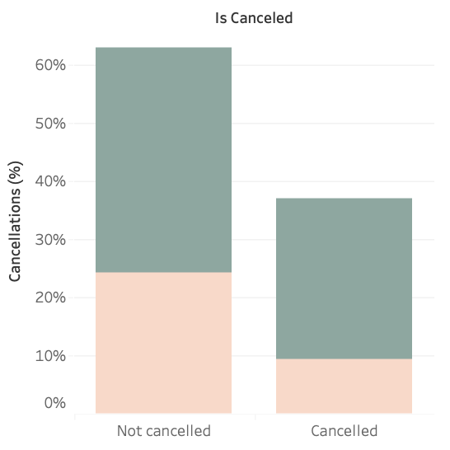

Database
Hotel Type
Is the hotel booking for a City or Resort hotel
Variable | Test statistic | p-value | Confidence level | Dependent? | Correlation | Dummy Variable (=1) | Coefficient | Intercept | Accuracy
Hotel Type | 2182,81 | 0,00 | 0,95 | yes | 0,14 | City Hotel | 0,62 | -0,95 | 0,63
Performed Contingency Test
Conclusion:
The hotel type influences the probability of the booking being cancelled.
The correlation between the two variables is low, entailing a weak relationship between both of them.
The regression coefficient shows that the expected difference in the cancellation probability when the booking is for a City Hotel and when it isn’t is 0,63.
The accuracy level is relatively high, making the previous conclusion more reliable.
Notes:
H0 = "Cancelations are independent of the hotel type"
H1 = "Cancelations are dependent of the hotel type"

Slide 10
Variables
Hotel Type
Is the hotel booking for a City or Resort hotel
Assigned vs Reserved room
Indication if the reserved room was the same it was assigned
Lead Time
Number of days that elapsed between the booking and the arrival date
Booking changes
Number of changes made to the booking
Only adults vs Family trip
Whether the trip included children or not
Deposit type
Indication on if the customer made a deposit to guarantee the booking.
Loyal Customer
Value indicating if the booking name was from a repeated guest
Days in waiting list
Number of days the booking was in the waiting list before it was confirmed
Previous cancellations
Number of previous bookings that were cancelled and not cancelled
Special requests
Number of special requests made by the customer

Slide 11
Variables
Hotel Type
Is the hotel booking for a City or Resort hotel
Assigned vs Reserved room
Indication if the reserved room was the same it was assigned
Lead Time
Number of days that elapsed between the booking and the arrival date
Booking changes
Number of changes made to the booking
Only adults vs Family trip
Whether the trip included children or not
Deposit type
Indication on if the customer made a deposit to guarantee the booking.
Loyal Customer
Value indicating if the booking name was from a repeated guest
Days in waiting list
Number of days the booking was in the waiting list before it was confirmed
Previous cancellations
Number of previous bookings that were cancelled and not cancelled
Special requests
Number of special requests made by the customer

Slide 12
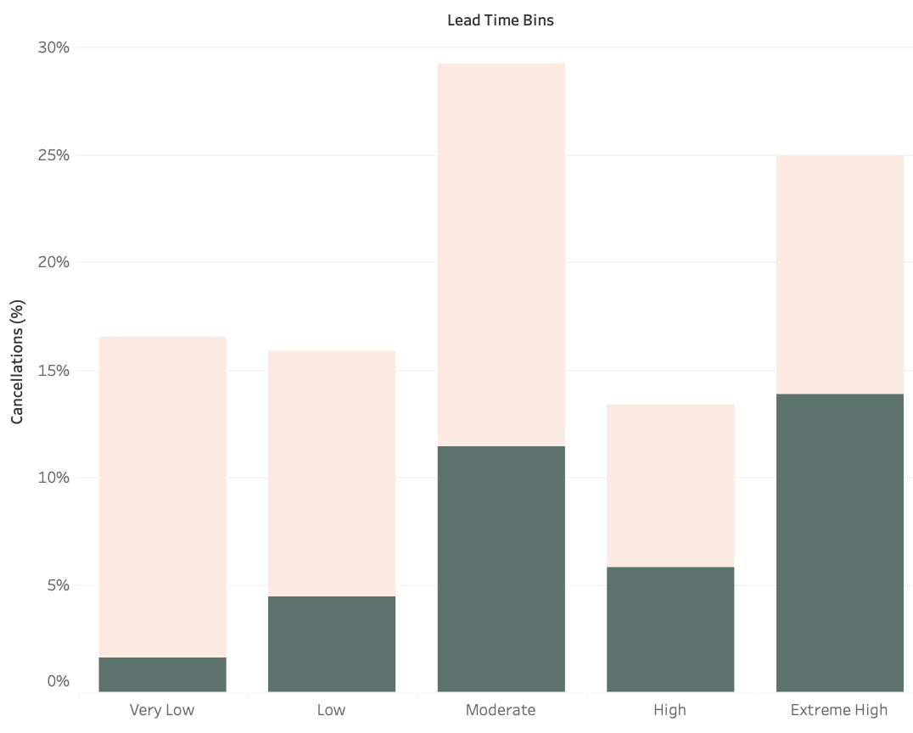

Database
Lead Time
Number of days that elapsed between the booking and the arrival date
Variable | Test statistic | p-value | Confidence level | Dependent? | Correlation | Dummy Variable (=1) | Coefficient | Intercept | Accuracy
Lead Time | 8909,06 | 0,00 | 0,95 | yes | 0,29 |  | 0,01 | -1.16 | 0,66
Performed Contingency Tests
Conclusion:
The lead time influences the probability of the booking being cancelled.
The correlation between the two variables is low, entailing a weak relationship between both of them.
The regression coefficient shows that when the lead time increases by one day, the probability of the booking being cancelled increases by 0,01.
The accuracy level is relatively high, making the previous conclusion more reliable.
Notes:
H0 = "Cancelations are independent of the hotel type"
H1 = "Cancelations are dependent of the hotel type"

Slide 13
Analysis Results
Variable | Test statistic | p-value | Confidence level | Dependent? | Correlation | Dummy Variable (=1) | Coefficient | Intercept | Accuracy
Hotel Type | 2182,81 | 0,00 | 0,95 | yes | 0,14 | City Hotel | 0,62 | -0,95 | 0,63
Lead Time | 8909,06 | 0,00 | 0,95 | yes | 0,29 |  | 0,01 | -1,16 | 0,66
Only adults vs Family Trip | 19,64 | 0,00 | 0,95 | yes | -0,01 | With Children | -0,1 | -0,52 | 0,63
Previous Guest | 626,82 | 0,00 | 0,95 | yes | -0,07 | Previous Guest | -1,15 | -0,5 | 0,63
Cancelled before | 8699,05 | 0,00 | 0,95 | yes | 0,27 | Cancelled | 3,05 | -0,66 | 0,67
Cancellation rate | 251,65 | 0,00 | 0,95 | yes | 0,82 | Cancelled | 5,99 | -3,4 | 0,95
Assigned vs Reserved Room | 7268,64 | 0,00 | 0,95 | yes | -0,25 | Changed Room | -2,53 | -0,34 | 0,63
Booking changes | 4197,98 | 0,00 | 0,95 | yes | -0,14 |  | -0,73 | -0,4 | 0,63
Deposit | 4197,98 | 0,00 | 0,95 | yes | -0.48, 0.48, -0.01 | No Deposit, Non Refund, Refundable | -1.9, 4.04, -2.14 | 0,98 | 0,75
Waiting List | 6,25 | 0,01 | 0,95 | yes | 0,054 |  | 0,01 | -0,54 | 0,63
Special Requests | 5,03 | 0,02 | 0,95 | yes | -0,24 |  | -0,74 | -0,16 | 0,63
All the variables impact the probability of the booking being cancelled

Slide 14
Analysis Results
Variable | Test statistic | p-value | Confidence level | Dependent? | Correlation | Dummy Variable (=1) | Coefficient | Intercept | Accuracy
Hotel Type | 2182,81 | 0,00 | 0,95 | yes | 0,14 | City Hotel | 0,62 | -0,95 | 0,63
Lead Time | 8909,06 | 0,00 | 0,95 | yes | 0,29 |  | 0,01 | -1,16 | 0,66
Only adults vs Family Trip | 19,64 | 0,00 | 0,95 | yes | -0,01 | With Children | -0,1 | -0,52 | 0,63
Previous Guest | 626,82 | 0,00 | 0,95 | yes | -0,07 | Previous Guest | -1,15 | -0,5 | 0,63
Cancelled before | 8699,05 | 0,00 | 0,95 | yes | 0,27 | Cancelled | 3,05 | -0,66 | 0,67
Cancellation rate | 251,65 | 0,00 | 0,95 | yes | 0,82 | Cancelled | 5,99 | -3,4 | 0,95
Assigned vs Reserved Room | 7268,64 | 0,00 | 0,95 | yes | -0,25 | Changed Room | -2,53 | -0,34 | 0,63
Booking changes | 4197,98 | 0,00 | 0,95 | yes | -0,14 |  | -0,73 | -0,4 | 0,63
Deposit | 4197,98 | 0,00 | 0,95 | yes | -0.48, 0.48, -0.01 | No Deposit, Non Refund, Refundable | -1.9, 4.04, -2.14 | 0,98 | 0,75
Waiting List | 6,25 | 0,01 | 0,95 | yes | 0,054 |  | 0,01 | -0,54 | 0,63
Special Requests | 5,03 | 0,02 | 0,95 | yes | -0,24 |  | -0,74 | -0,16 | 0,63

Slide 15
Analysis Results
Variable | Test statistic | p-value | Confidence level | Dependent? | Correlation | Dummy Variable (=1) | Coefficient | Intercept | Accuracy
Hotel Type | 2182,81 | 0,00 | 0,95 | yes | 0,14 | City Hotel | 0,62 | -0,95 | 0,63
Lead Time | 8909,06 | 0,00 | 0,95 | yes | 0,29 |  | 0,01 | -1,16 | 0,66
Only adults vs Family Trip | 19,64 | 0,00 | 0,95 | yes | -0,01 | With Children | -0,1 | -0,52 | 0,63
Previous Guest | 626,82 | 0,00 | 0,95 | yes | -0,07 | Previous Guest | -1,15 | -0,5 | 0,63
Cancelled before | 8699,05 | 0,00 | 0,95 | yes | 0,27 | Cancelled | 3,05 | -0,66 | 0,67
Cancellation rate | 251,65 | 0,00 | 0,95 | yes | 0,82 | Cancelled | 5,99 | -3,4 | 0,95
Assigned vs Reserved Room | 7268,64 | 0,00 | 0,95 | yes | -0,25 | Changed Room | -2,53 | -0,34 | 0,63
Booking changes | 4197,98 | 0,00 | 0,95 | yes | -0,14 |  | -0,73 | -0,4 | 0,63
Deposit | 4197,98 | 0,00 | 0,95 | yes | -0.48, 0.48, -0.01 | No Deposit, Non Refund, Refundable | -1.9, 4.04, -2.14 | 0,98 | 0,75
Waiting List | 6,25 | 0,01 | 0,95 | yes | 0,054 |  | 0,01 | -0,54 | 0,63
Special Requests | 5,03 | 0,02 | 0,95 | yes | -0,24 |  | -0,74 | -0,16 | 0,63

Slide 16
Analysis Results
Variable | Test statistic | p-value | Confidence level | Dependent? | Correlation | Dummy Variable (=1) | Coefficient | Intercept | Accuracy
Hotel Type | 2182,81 | 0,00 | 0,95 | yes | 0,14 | City Hotel | 0,62 | -0,95 | 0,63
Lead Time | 8909,06 | 0,00 | 0,95 | yes | 0,29 |  | 0,01 | -1,16 | 0,66
Only adults vs Family Trip | 19,64 | 0,00 | 0,95 | yes | -0,01 | With Children | -0,1 | -0,52 | 0,63
Previous Guest | 626,82 | 0,00 | 0,95 | yes | -0,07 | Previous Guest | -1,15 | -0,5 | 0,63
Cancelled before | 8699,05 | 0,00 | 0,95 | yes | 0,27 | Cancelled | 3,05 | -0,66 | 0,67
Cancellation rate | 251,65 | 0,00 | 0,95 | yes | 0,82 | Cancelled | 5,99 | -3,4 | 0,95
Assigned vs Reserved Room | 7268,64 | 0,00 | 0,95 | yes | -0,25 | Changed Room | -2,53 | -0,34 | 0,63
Booking changes | 4197,98 | 0,00 | 0,95 | yes | -0,14 |  | -0,73 | -0,4 | 0,63
Deposit | 4197,98 | 0,00 | 0,95 | yes | -0.48, 0.48, -0.01 | No Deposit, Non Refund, Refundable | -1.9, 4.04, -2.14 | 0,98 | 0,75
Waiting List | 6,25 | 0,01 | 0,95 | yes | 0,054 |  | 0,01 | -0,54 | 0,63
Special Requests | 5,03 | 0,02 | 0,95 | yes | -0,24 |  | -0,74 | -0,16 | 0,63

Slide 17
Analysis Results
Variable | Test statistic | p-value | Confidence level | Dependent? | Correlation | Dummy Variable (=1) | Coefficient | Intercept | Accuracy
Hotel Type | 2182,81 | 0,00 | 0,95 | yes | 0,14 | City Hotel | 0,62 | -0,95 | 0,63
Lead Time | 8909,06 | 0,00 | 0,95 | yes | 0,29 |  | 0,01 | -1,16 | 0,66
Only adults vs Family Trip | 19,64 | 0,00 | 0,95 | yes | -0,01 | With Children | -0,1 | -0,52 | 0,63
Previous Guest | 626,82 | 0,00 | 0,95 | yes | -0,07 | Previous Guest | -1,15 | -0,5 | 0,63
Cancelled before | 8699,05 | 0,00 | 0,95 | yes | 0,27 | Cancelled | 3,05 | -0,66 | 0,67
Cancellation rate | 251,65 | 0,00 | 0,95 | yes | 0,82 | Cancelled | 5,99 | -3,4 | 0,95
Assigned vs Reserved Room | 7268,64 | 0,00 | 0,95 | yes | -0,25 | Changed Room | -2,53 | -0,34 | 0,63
Booking changes | 4197,98 | 0,00 | 0,95 | yes | -0,14 |  | -0,73 | -0,4 | 0,63
Deposit | 4197,98 | 0,00 | 0,95 | yes | -0.48, 0.48, -0.01 | No Deposit, Non Refund, Refundable | -1.9, 4.04, -2.14 | 0,98 | 0,75
Waiting List | 6,25 | 0,01 | 0,95 | yes | 0,054 |  | 0,01 | -0,54 | 0,63
Special Requests | 5,03 | 0,02 | 0,95 | yes | -0,24 |  | -0,74 | -0,16 | 0,63

Slide 18
Analysis Results
Variable | Test statistic | p-value | Confidence level | Dependent? | Correlation | Dummy Variable (=1) | Coefficient | Intercept | Accuracy
Hotel Type | 2182,81 | 0,00 | 0,95 | yes | 0,14 | City Hotel | 0,62 | -0,95 | 0,63
Lead Time | 8909,06 | 0,00 | 0,95 | yes | 0,29 |  | 0,01 | -1,16 | 0,66
Only adults vs Family Trip | 19,64 | 0,00 | 0,95 | yes | -0,01 | With Children | -0,1 | -0,52 | 0,63
Previous Guest | 626,82 | 0,00 | 0,95 | yes | -0,07 | Previous Guest | -1,15 | -0,5 | 0,63
Cancelled before | 8699,05 | 0,00 | 0,95 | yes | 0,27 | Cancelled | 3,05 | -0,66 | 0,67
Cancellation rate | 251,65 | 0,00 | 0,95 | yes | 0,82 | Cancelled | 5,99 | -3,4 | 0,95
Assigned vs Reserved Room | 7268,64 | 0,00 | 0,95 | yes | -0,25 | Changed Room | -2,53 | -0,34 | 0,63
Booking changes | 4197,98 | 0,00 | 0,95 | yes | -0,14 |  | -0,73 | -0,4 | 0,63
Deposit | 4197,98 | 0,00 | 0,95 | yes | -0.48, 0.48, -0.01 | No Deposit, Non Refund, Refundable | -1.9, 4.04, -2.14 | 0,98 | 0,75
Waiting List | 6,25 | 0,01 | 0,95 | yes | 0,054 |  | 0,01 | -0,54 | 0,63
Special Requests | 5,03 | 0,02 | 0,95 | yes | -0,24 |  | -0,74 | -0,16 | 0,63

Slide 19

Future testing…
Testing the regression coefficients!
We want to understand if the variable is statistically significant in predicting the target variable.
H₀: β = 0
H₁: β ≠ 0
If the p-value is less than the chosen significance level, you can reject the null hypothesis and conclude that the corresponding predictor variable is statistically significant in predicting the target variable.
Logistic Regression
Linear Regression
Wald Test
Z-score/T-test

Slide 20

Thank you!

